Slide 1
Matrix Inversion Capstone

Slide 2
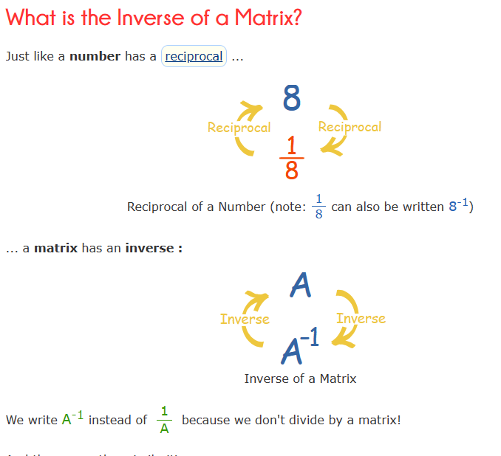
Matrix Inversion
Source: Inverse of a Matrix (mathsisfun.com)

Slide 3
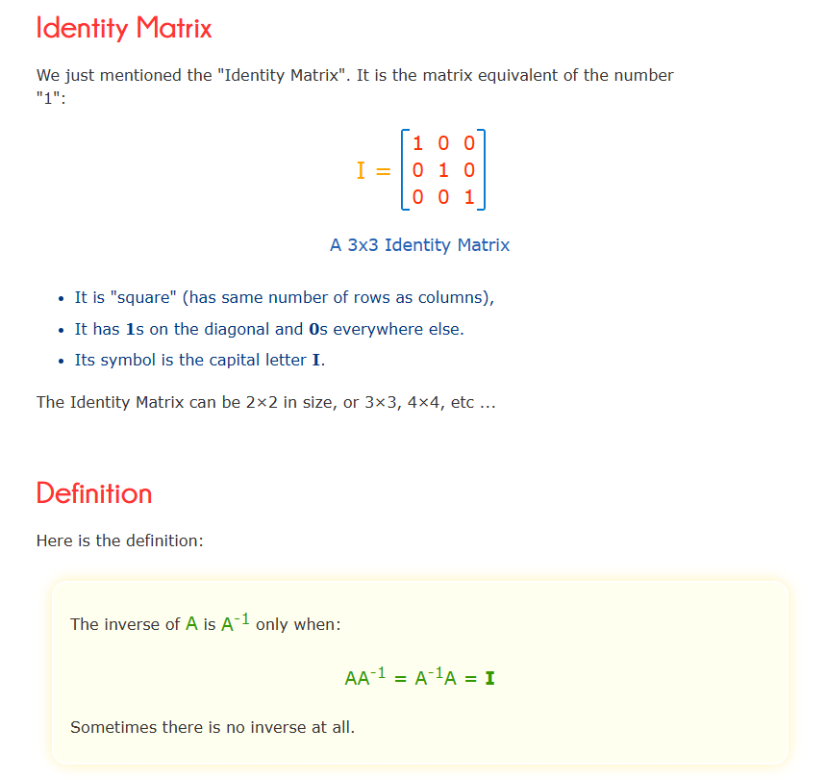
Source: Inverse of a Matrix (mathsisfun.com)

Slide 4
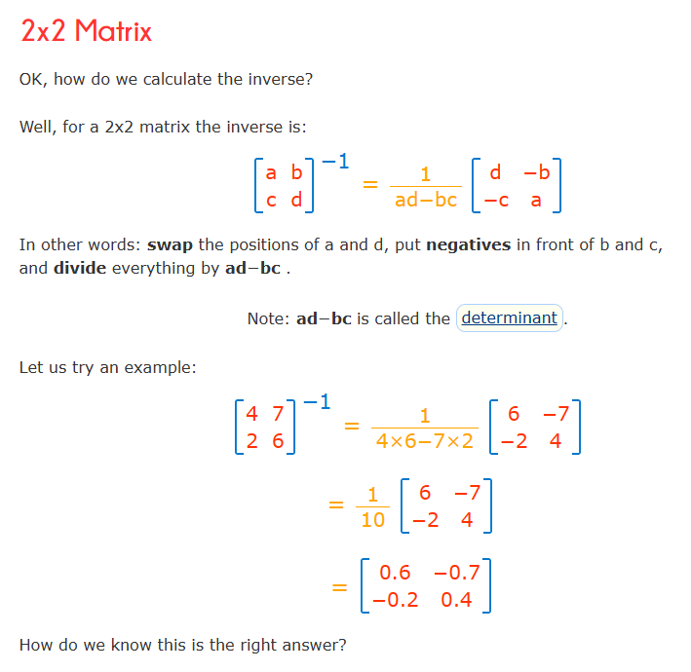
Source: Inverse of a Matrix (mathsisfun.com)

Slide 5
Preliminary Thoughts - Sprint 1
Investigate linear regression between a matrix and its inverse for each matrix element
I will consider a 3x3 matrix with elements between 0 and 6 - not to simple but not overly complicated. This is a preliminary analysis - next sprint planning can be done to possibly test other matrices or go in a different direction entirely
Consider a linear regression of all elements of original matrix
Also consider all possible combinations of each element multiplied by another element in the matrix a00*a01, a00*a02, etc
By lucky mistake i also added the square of each element to the linear regression and found this as a way to increase the r squared value
With further trial and error I found some better tests as well

Slide 6
Possible Impact of Sprint 1 results
Would be very interesting to see the r squared values for the various matrix elements
And see if there is an improvement when considering elements of the matrix multiplied by each other
Possibly find a linear regression to determine the inverse of a matrix

Slide 7
Applications of Matrix Inversion
Markov Chains: Matrix inversion is utilized in the study of Markov chains, a mathematical system that undergoes transitions between different states. The stationary distribution of a Markov chain can be found by solving a system of linear equations involving matrix inversion.
Optimization: In optimization problems, especially in linear programming, matrix inversion is employed to find optimal solutions. The inversion of matrices is often part of algorithms that iteratively improve solutions until an optimum is reached.
Control Systems: In control theory, matrix inversion is used to design controllers for dynamic systems. It plays a crucial role in determining the control law that stabilizes a system and achieves desired performance.
Computer Graphics: Matrix inversion is used in computer graphics to transform and manipulate 3D graphics. Techniques like affine transformations and perspective projection involve matrix operations, including inversion.
Image Processing: In image processing, matrix inversion is applied to techniques like image registration and geometric transformations. This is important in aligning and transforming images for further analysis.
Quantum Mechanics: Matrix inversion is frequently used in quantum mechanics, particularly in the representation of quantum states and the evolution of quantum systems.
Machine Learning: In machine learning, matrix inversion can be involved in certain algorithms, such as linear regression or certain optimization problems. However, due to computational considerations, alternative methods like gradient descent are often preferred.

Slide 8
Results of Linear Regression
R Squared values were very low.
However I stumbled upon how the r squared value increased significantly when the square of each matrix element was added to the linear regression.
This got me thinking and i thought about squaring each element before multiplying it by every other element in the matrix, along with the cube of itself. This also significantly increased the r squared value.
This could have very well been an occurrence for the generated set of matrices, so I tried with 6 different sets and this pattern remained.
I really like this result and look forward to using it in the next sprints.

Slide 9
Overview of tests and results
Test 1: linear regression between matrix elements and inverse matrix elements
Test 2: linear regression with test 1 and all possible combinations of one matrix element multiplied by every other matrix element
Test 3: linear regression with test 2 and the square of each matrix element
Test 4: linear regression with test 1 and all possible combinations of one matrix element squared and multiplied by every other matrix element and the cube of each matrix element
Note how Test 4 does not even the parts of test 3 that included all possible combinations of one matrix element multiplied by every other matrix element - these are the tests I am reporting to demonstrate the importance of the aspect of test 4

Slide 10
Results
R Squared values
 | Random Seed 1 | Random Seed 2 | Random Seed 3 | Random Seed 4 | Random Seed 5 | Random Seed 6 | Random Seed 7
Test 1 | 0.001 | 0.0035 | 0.0025 | 0.004 | 0.0022 | 0.0026 | 0.0034
Test 2 | 0.0035 | 0.024 | 0.012 | 0.029 | 0.0088 | 0.014 | 0.02
Test 3 | 0.0047 | 0.026 | 0.015 | 0.034 | 0.011 | 0.017 | 0.024
Test 4 | 0.0087 | 0.04 | 0.024 | 0.06 | 0.017 | 0.027 | 0.037
It is very clear that each following test always increases the r squared value and that test 4 is the best always bettering test three by at least a third of test 4. These results clearly show the importance of test 4 along with the increasing importance of each test

Slide 11
Results
To recap, the first result is that adding each matrix element multiplied by every other matrix element to simply a regression of a matrix and its inverse increases the r squared value.
Adding the square of each matrix element to the regression increases the r squared value.
Using the square of each element further multiplied by every other matrix element, along with the cube of each matrix element increases the r squared value to a level higher then other tests

Slide 12
Notes
Further tests will need to be conducted to ensure that these results were not a random occurrence, however there is a clear pattern in these results.
Further investigation will be required into determining if bigger numbers produce a larger r squared values in which case these results would not be significant. Either way this forms a good basis for sprint 1 in planning for other sprints

Slide 13
Next Steps
At this time I am considering non invertible matrices and creating a formula that generate a numerically close inversion of a matrix that is non invertible. Interestingly google and youtube do not have a solution for this, further investigation required.
Also neural nets and tensorflow for determining a formula for the inverse of a matrix, however i will need to consider larger matrices as the formula for invertible matrices of size 2 and 3 is very simple. Inverting larger matrices is more complicated, if an exact inverse exists.

